Slide 1
Applet

Slide 2
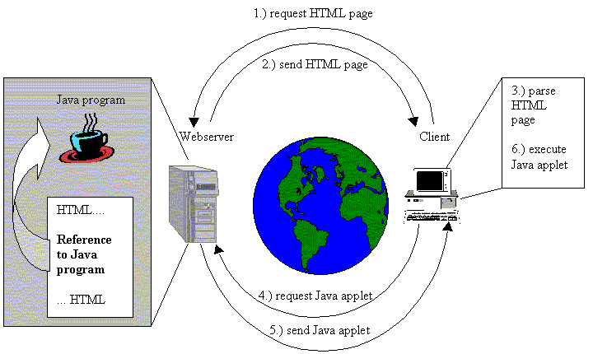
What is an applet?
applet: a Java program that can be inserted into a web page and run by loading that page in a browser
  brings web pages to life with interactive content, multimedia, games, and more
  the feature of Java that is primarily responsible for its initial popularity
  users can run applets simply by
  visiting a web page that
  contains an applet program
  (if they have the Java runtime
  environment installed on their
  computer)

Slide 3
Applets
Graphical Java programs
Run inside web browser or AppletViewer
Platform-neutral

Slide 4
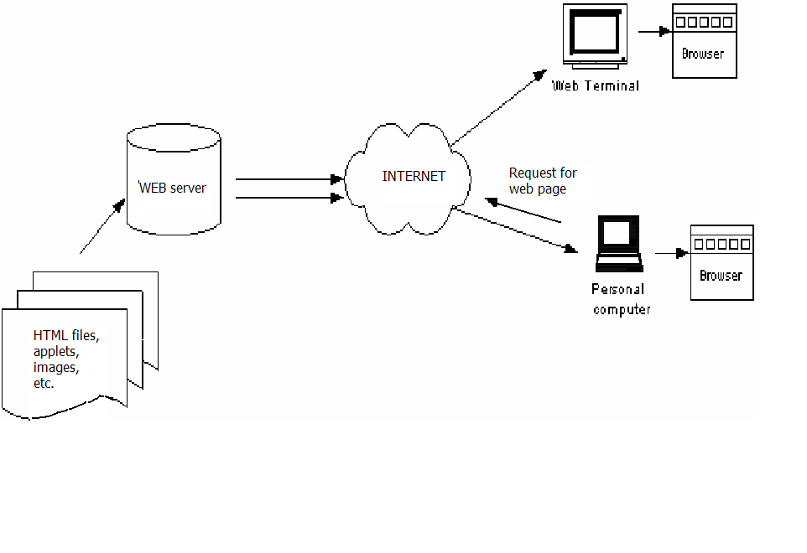
Web Browsers Accessing a Web Page
User enters URL for a web site …………..

Slide 5
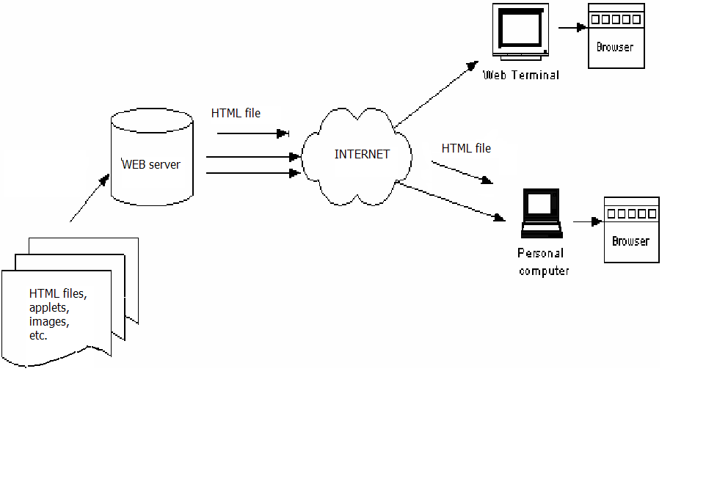
HTML file sent back from web server ………..

Slide 6

Applet byte code file sent down from server and interpreted by browser ..

Slide 7
Applets
An applet is a Panel that allows interaction with a Java program
A applet is typically embedded in a Web page and can be run from a browser
You need special HTML in the Web page to tell the browser about the applet
For security reasons, applets run in a sandbox: they have no access to the client’s file system

Slide 8
What is an applet
You write an applet by extending the class Applet
Applet is just a class like any other; you can even use it in applications if you want
When you write an applet, you are only writing part of a program
The browser supplies the main method

Slide 9
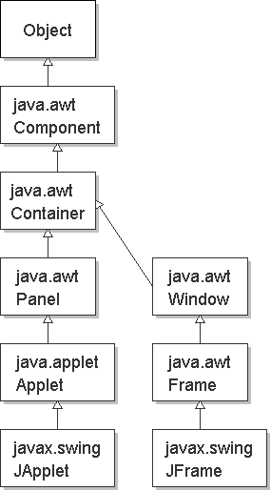
Applet classes in Java
implementation
  a top-level container, like a JFrame
  behaves more like a JPanel
  class javax.swing.JApplet
java.lang.Object
java.awt.Component
  java.awt.Container
    java.awt.Panel
      java.applet.Applet
        javax.swing.JApplet

Slide 10
The genealogy of Applet
java.lang.Object
|
+----java.awt.Component
|
+----java.awt.Container
|
+----java.awt.Panel
|
+----java.applet.Applet

Slide 11
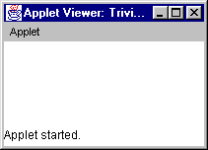
The simplest possible applet
TrivialApplet.java
import java.applet.Applet;
public class TrivialApplet extends Applet { }
TrivialApplet.html
<applet
code="TrivialApplet.class”
width=150 height=100>
</applet>

Slide 12
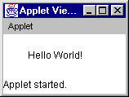
The simplest reasonable applet
import java.awt.*;
import java.applet.Applet;
public class HelloWorld extends Applet {
public void paint( Graphics g ) {
g.drawString( "Hello World!", 30, 30 );
}
}

Slide 13
Applet methods
public void init ()
public void start ()
public void stop ()
public void destroy ()
public void paint (Graphics)
Also:
public void repaint()
public void update (Graphics)
public void showStatus(String)
public String getParameter(String)

Slide 14
Why an applet works
You write an applet by extending the class Applet
Applet defines methods init( ), start( ), stop( ), paint(Graphics), destroy( )
These methods do nothing--they are stubs
You make the applet do something by overriding these methods

Slide 15
Applet life cycle
browser visits page containing an applet
  browser calls init on that applet, once
  browser calls start on that applet
browser goes away from that page
  browser calls stop on that applet
browser comes back to that page
  browser calls start again on that applet
...
browser shuts down
  browser calls destroy on the applet, once
init()
start()
do some work
stop()
destroy()

Slide 16
public void init ( )
This is the first method to execute
It is an ideal place to initialize variables
It is the best place to define the GUI Components (buttons, text fields, scrollbars, etc.), lay them out, and add listeners to them
  put code that would have been in GUI's constructor in init instead
Almost every applet you ever write will have an init( ) method

Slide 17
public void start ( )
Not always needed
Called after init( )
  put code that would have been in GUI's main method in start instead
Called each time the page is loaded and restarted
Used mostly in conjunction with stop( )
start() and stop( ) are used when the Applet is doing time-consuming calculations that you don’t want to continue when the page is not in front

Slide 18
public void stop( )
Not always needed
Called when the browser leaves the page
Called just before destroy( )
Use stop( ) if the applet is doing heavy computation that you don’t want to continue when the browser is on some other page
Used mostly in conjunction with start()

Slide 19
public void destroy( )
Seldom needed
Called after stop( )
Use to explicitly release system resources (like threads)
System resources are usually released automatically

Slide 20
Methods are called in this order
init and destroy are only called once each
start and stop are called whenever the browser enters and leaves the page
do some work is code called by your listeners
paint is called when the applet needs to be repainted
init()
start()
do some work
stop()
destroy()

Slide 21
public void paint(Graphics g)
Needed if you do any drawing or painting other than just using standard GUI Components
Any painting you want to do should be done here, or in a method you call from here
Painting that you do in other methods may or may not happen
Never call paint(Graphics), call repaint( )

Slide 22
repaint( )
Call repaint( ) when you have changed something and want your changes to show up on the screen
repaint( ) is a request--it might not happen
When you call repaint( ), Java schedules a call to update(Graphics g)

Slide 23
update( )
When you call repaint( ), Java schedules a call to update(Graphics g)
Here's what update does:
  public void update(Graphics g) {
  // Fills applet with background color, then
  paint(g);
  }

Slide 24
Sample Graphics methods
A Graphics is something you can paint on
g.drawString(“Hello”, 20, 20);
Hello
g.drawRect(x, y, width, height);
g.fillRect(x, y, width, height);
g.drawOval(x, y, width, height);
g.fillOval(x, y, width, height);
g.setColor(Color.red);

Slide 25
Painting at the right time is hard
Rule #1: Never call paint(Graphics g), call repaint( ).
Rule #2: Do all your painting in paint, or in a method that you call from paint.
Rule #3: If you paint on any Graphics other than the Applet’s, call its update method from the Applet’s paint method.
Rule #4. Do your painting in a separate Thread.
These rules aren't perfect, but they should help.

Slide 26
Other useful Applet methods
System.out.println(String s)
  Works from appletviewer, not from browsers
  Automatically opens an output window.
showStatus(String) displays the String in the applet’s status line.
  Each call overwrites the previous call.
  You have to allow time to read the line!

Slide 27
Applets are not magic!
Anything you can do in an applet, you can do in an application.
You can do some things in an application that you can’t do in an applet.
If you want to access files from an applet, it must be a “trusted” applet.
Trusted applets are beyond the scope of this course.

Slide 28
A very simple applet
An applet can be treated like a drawing panel or a container to hold other components.
import java.awt.*;
import javax.swing.*;
public class HelloWorldApplet extends JApplet {
public void paint(Graphics g) {
super.paint(g);
g.drawString("Hello World!", 30, 30);
}
}

Slide 29
Applet inside a web page
applet programs live inside web pages
when the browser reaches the web page:
  all necessary class files are downloaded from server, loaded onto JVM in web browser, and executed

Slide 30
HTML (web pages)
Web pages are written in the HyperText Markup Language (HTML)
Web pages have two main sections:
  head: header information
  (not shown on screen)
  body: actual text of the web page
HTML text is placed
into tags between
< and >
<HTML>
<HEAD>
<BODY>
<TITLE>
(content)

Slide 31
An applet is accessed by an HTML file.
HTML is a ‘mark-up’ language (it adds to text content by marking it up with tags)
Browsers display the text and process (render) the tags
For example, a file might begin with the line:
IS C313 <i> Homework </i> Assignment
The browser would display:
IS C313 Homework Assignment

Slide 32
<HTML>
<u> here comes an applet </u>
<applet code= “file.class” width =500 height=500>
</applet>
</HTML>
When a browser renders this HTML file, it will display underlined text and the applet whose byte code is in the file “file.class”

Slide 33
Web page with an applet
Put a page like this in your project's folder:
<HTML>
<HEAD>
<TITLE>My Applet Page</TITLE>
</HEAD>
<BODY>
<applet
code=" HelloWorldApplet.class”
width=150 height=100>
</applet>
</BODY>
</HTML>

Slide 34
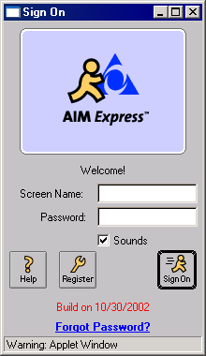
JApplet restrictions
can't read or write any files on user's hard disk
can't make network connections to computers other than web server hosting applet
can't execute other programs
can't read much information about system on which it is running
any window popped up by applet will have a warning at the bottom

Slide 35
Other JApplet methods
public void showStatus(String str)
Places the given text into the browser's status bar.
public URL getCodeBase()
Returns the URL of the folder where this applet's web page resides on the web.

Slide 36
Passing parameter to applet
Parameters can be placed in the HTML code of your web page, which your applet can read:
<!-- code="mypackage/MyApplet.class"
width=400 height=300>
<PARAM name="password" value="Tacoma"> </PARAM>
-->
Methods in the JApplet class:
  public String getParameter(String name)
  Returns the value of the parameter with the given name.
  String password = this.getParameter("password");
  public String[][] getParameterInfo()
  Returns an array of all parameter names, descriptions, and values.

